Slide 1
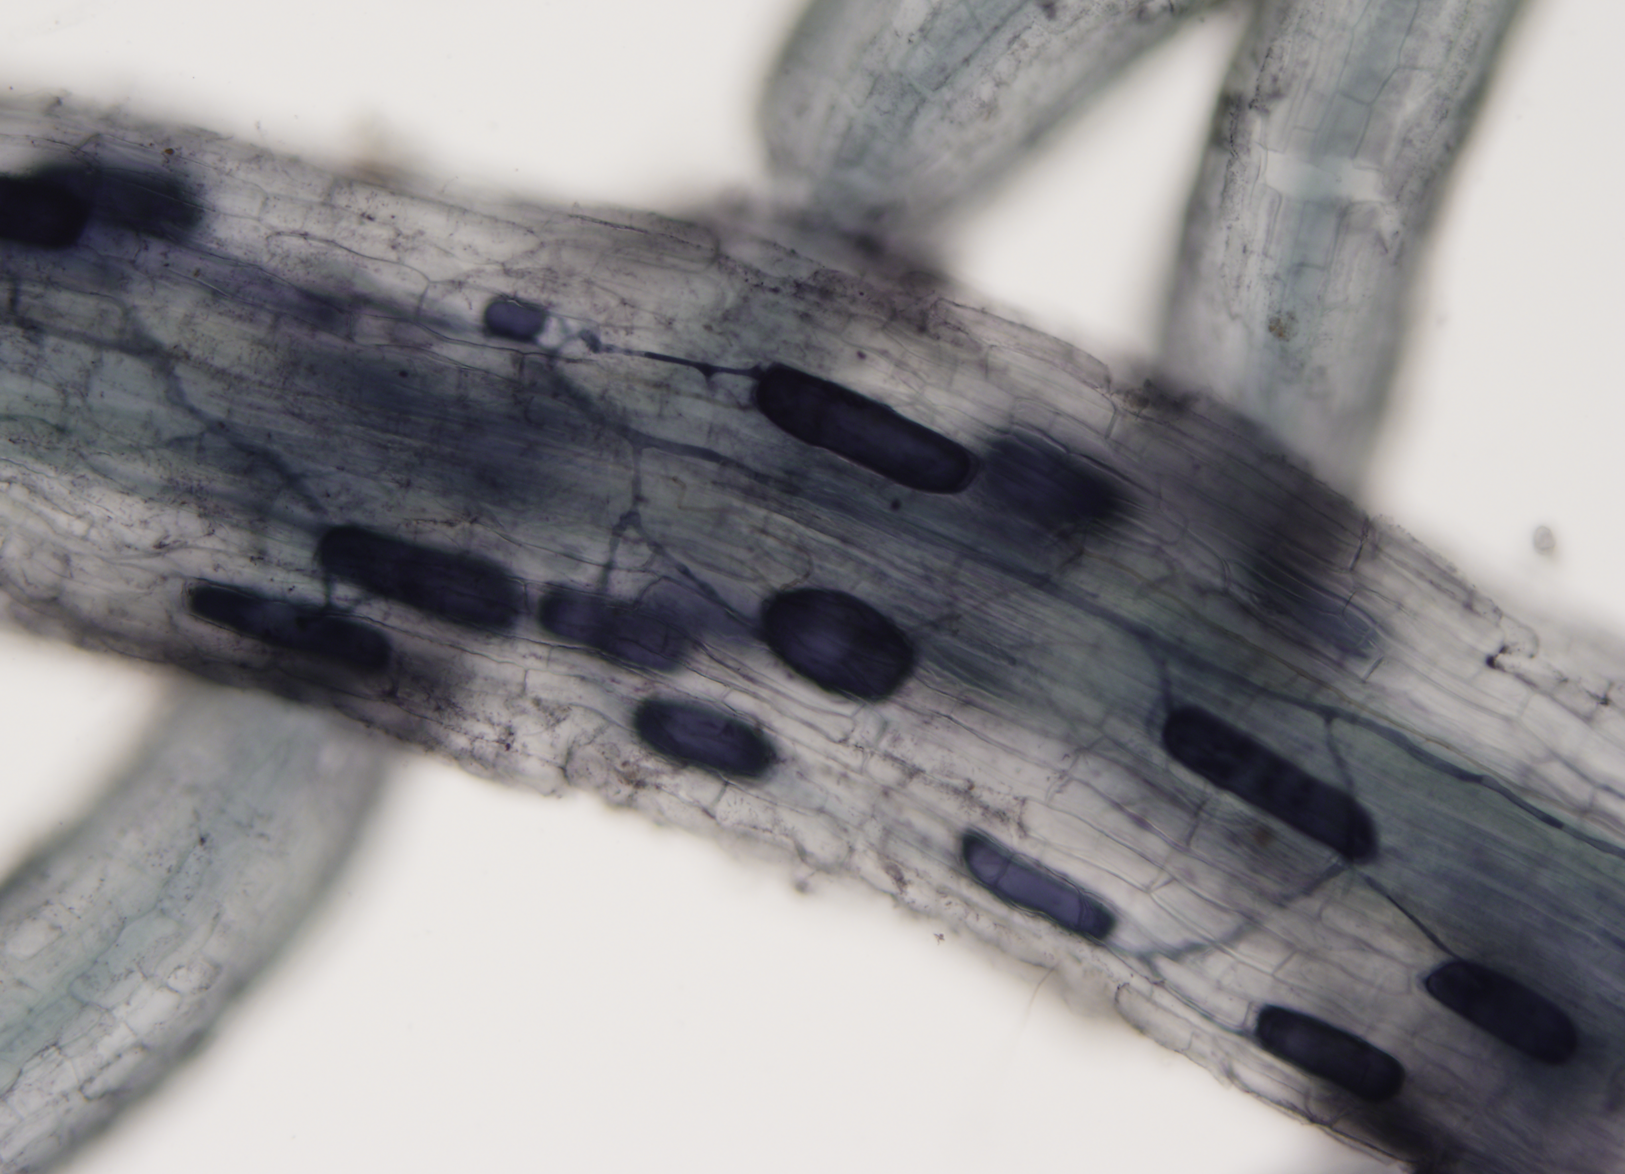


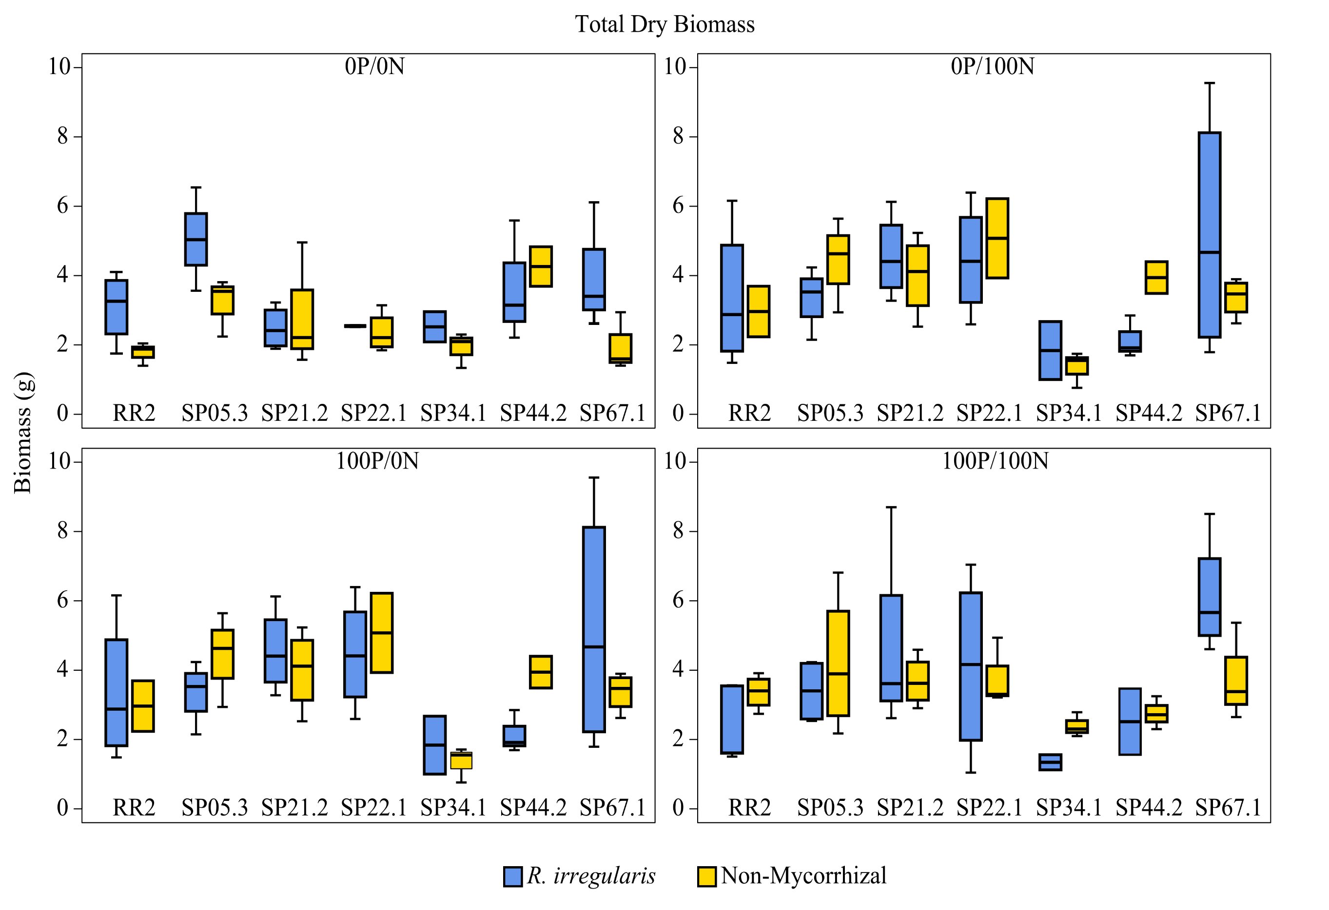
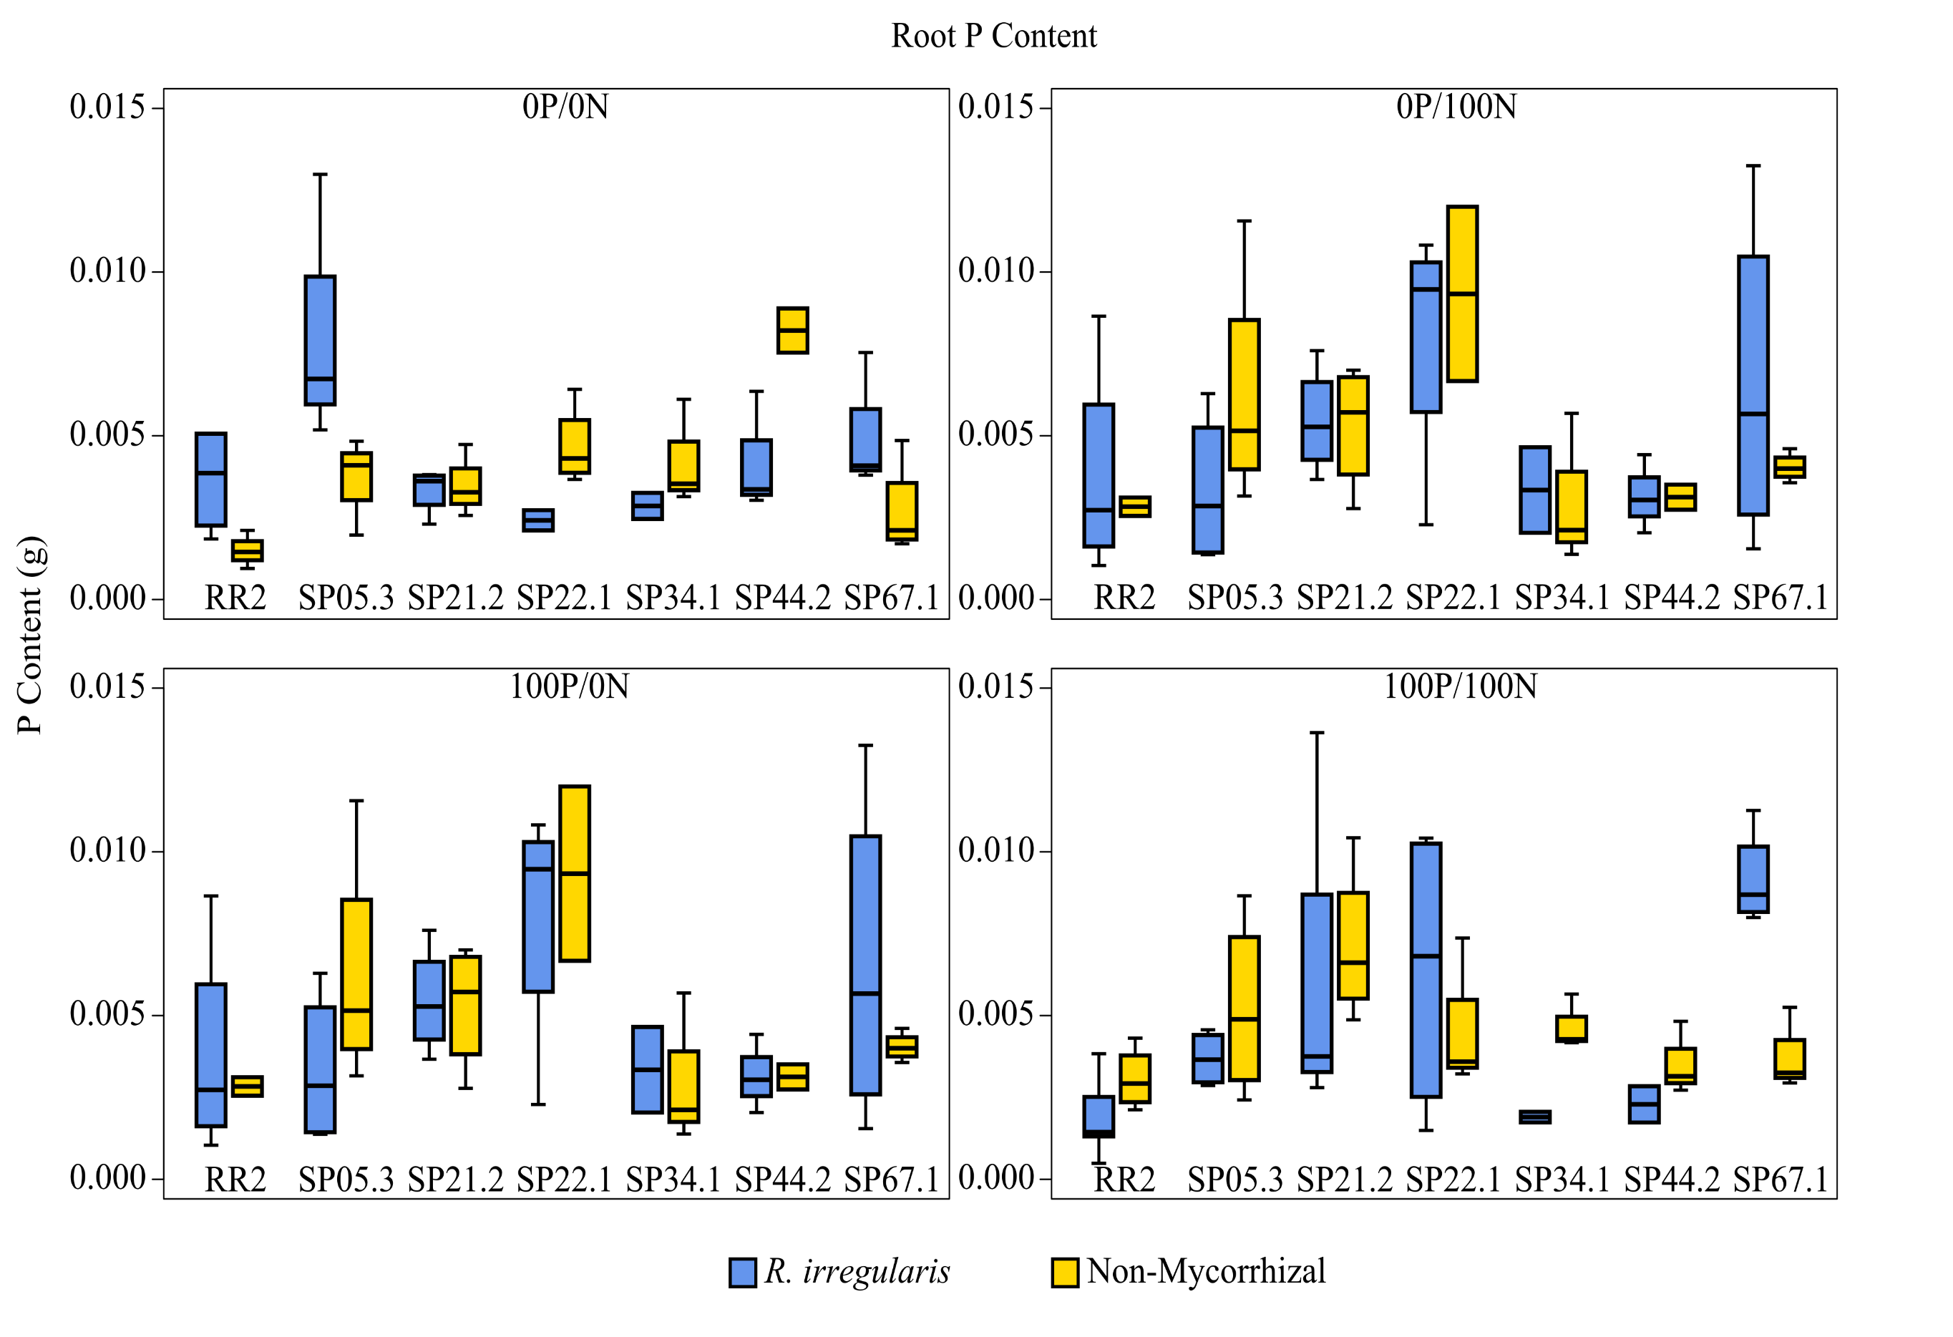
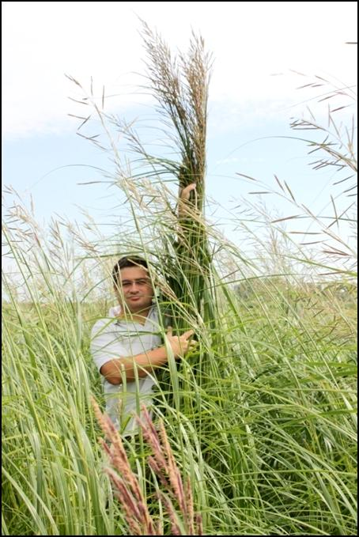
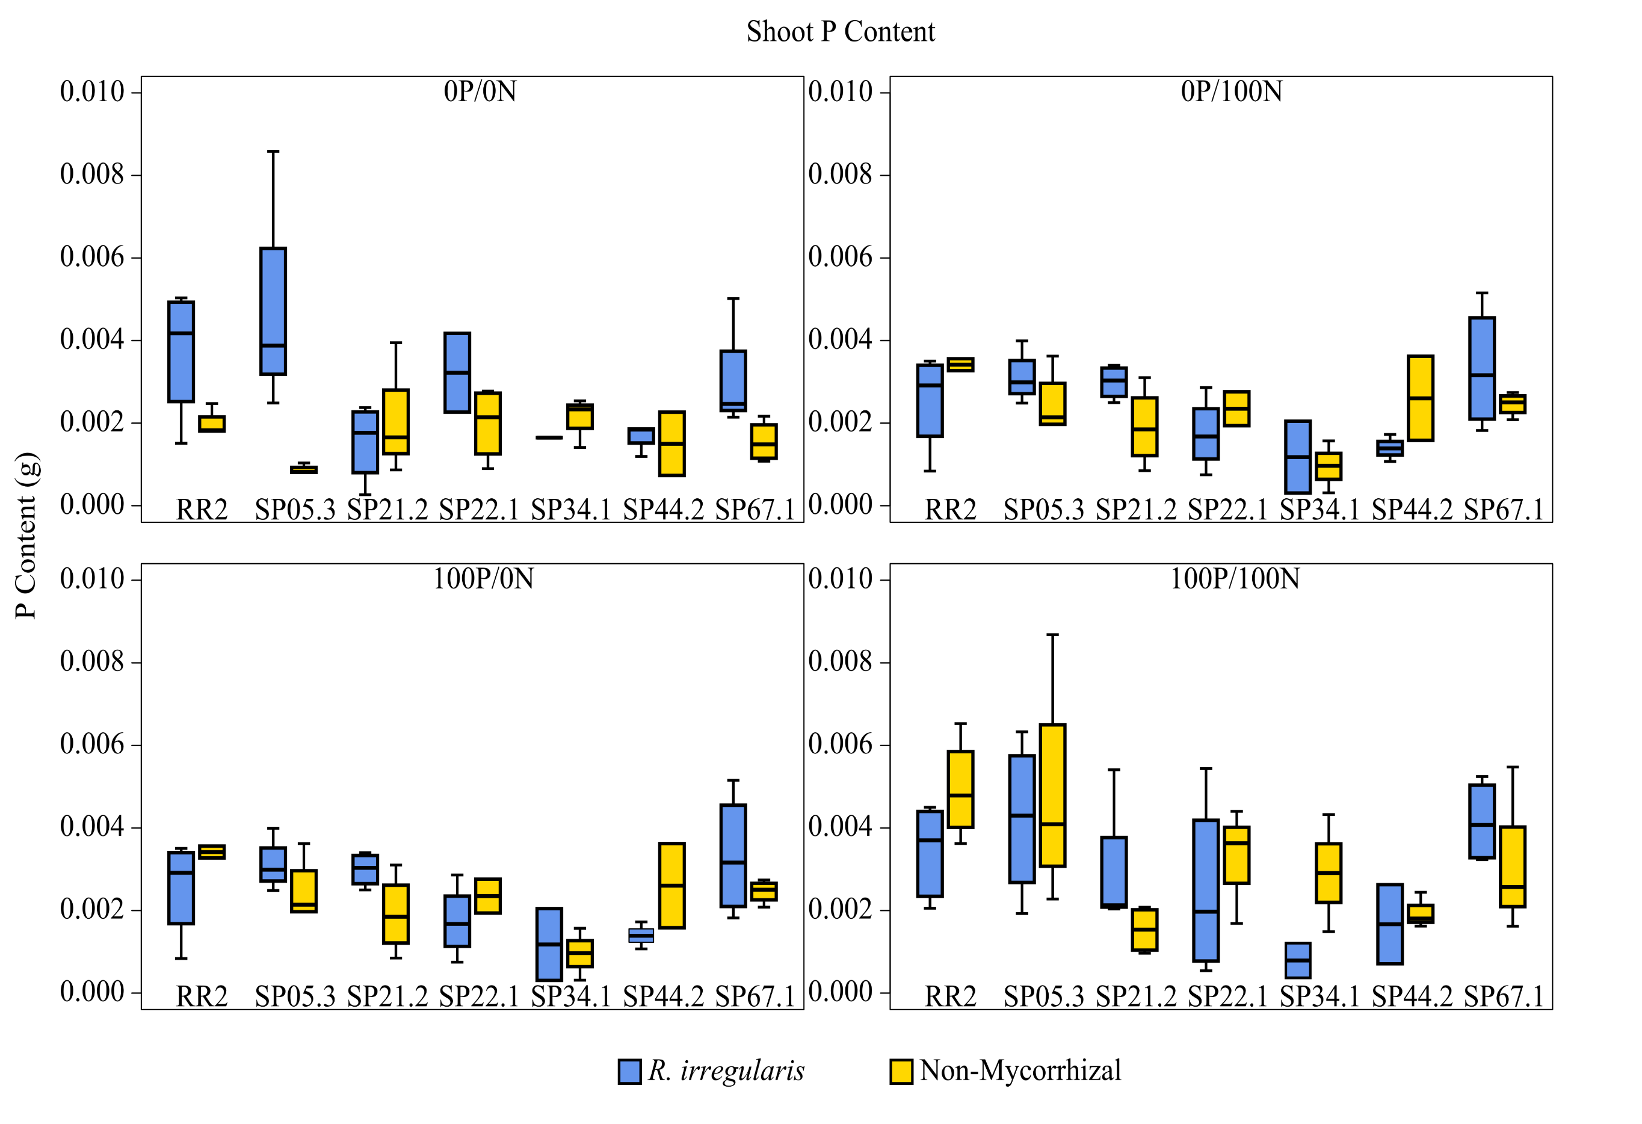
Plant-microbe interactions affect biomass production of Spartina pectinata, a potential bioenergy crop
Merritt B. Burch, Brandon Monier, Jose Gonzalez, and Heike Bücking
Department of Biology and Microbiology. South Dakota State University. Brookings, SD 57007
Introduction:
Results:
Arbuscular mycorrhizal (AM) fungi are obligate biotrophs that:
Form mutualistic interactions with 65-80% of all terrestrial plants (Fig. 1);
Help in nutrient uptake of P, N, Mg, S (Newsham et al. 1995);
Provide resistance against biotic (pathogens) and abiotic (heavy metals, salinity, etc.) stresses; and
Can serve as potential biofertlizers.
Fig. 1: AM symbiosis of S. pectinata colonization with Rhizophagus irregularis. Shown are fungal hyphae and spores.
We studied the potential of AM fungi to increase the biomass production of Spartina pectinata (prairie cordgrass) because this potential bioenergy crop:
Produces large biomass yields on marginal lands (Boe et al. 2009);
Provides a habitat for wildlife;
Assists in CO₂ sequestration (Boe et al. 2009); and
Helps with erosion control and wetland restoration (NCRS 2000).
Fig. 4: Total plant dry mass of mycorrhizal (blue bars) and non-mycorrhizal (red bars) plants of seven prairie cordgrass genotypes after growth under different nutrient supply conditions. Shown are boxplots with median and range of the data.
Fig. 5: Root P contents of mycorrhizal and non-mycorrhizal plants of all seven prairie cordgrass genotypes under different nutrient supply conditions.
Fig. 2: Dr. Gonzalez next to native stands of prairie cordgrass
Objectives:
To determine if there is any genetic variability within prairie cordgrass genotypes in response to mycorrhizal colonization under different nutrient supply conditions.
Materials and Methods:
Seven genetically distinct prairie cordgrass genotypes collected from around the Northern Great Plains were transplanted into pots and grown under standard greenhouse conditions.
Half of the plants were inoculated with spores from R. irregularis and the other half remained non-mycorrhizal.
Plants were potted with a mixture of 70% sand, 20% organic soil, and 10% perlite and every 5-6 weeks the plants were fertilized with their respective nutrient solution.
Fig. 6: Shoot P contents of mycorrhizal and non-mycorrhizal plants of all seven prairie cordgrass genotypes under different nutrient supply conditions.
Fig. 7: Mycorrhizal responsiveness of the prairie cordgrass genotypes in terms of total biomass under different nutrient supply conditions.
Discussion and Conclusions:
References:
Mycorrhizal plants of the genotypes RR2, SP21.2, and SP 67.1 form the highest biomass under low nutrient input conditions (0P/0N) (Fig. 4).
The biomass increases of the responsive genotypes were mainly the result of an increase in the P nutrition particularly under low input conditions (Fig. 5, 6).
Negative mycorrhizal growth responses were not observed, but under high input conditions, most genotypes should neutral mycorrhizal growth responses (Fig. 7). Mycorrhizal growth benefits are often context dependent and lower under high input conditions (Smith et al. 2011).
Long term goal of these studies is to identify those genotypes that respond positively to the mycorrhizal colonization and that are most suited to produce biomass under low input conditions.
Boe, A., V. Owens, J. Gonzalez-Hernandez, J. Stein, D. K. Lee, and B. C. Koo. "Morphology and Biomass Production of Prairie Cordgrass on Marginal Lands." GCB Bioenergy 1.3 (2009): 240-50.
Fellbaum, Carl R., Jerry A. Mensah, Adam J. Cloos, Gary E. Strahan, Philip E. Pfeffer, Toby E. Kers, and Heike Bücking. "Fungal Nutrient Allocation in Common Mycorrhizal Networks Is Regulated by the Carbon Source Strength of Individual Host Plants." New Phytologist 203.2 (2014): 646-56.
McGonigle T. P., Miller H. M, Evans G. D, Fairchild L. G, and J. A. Swan. "A New Method Which Gives an Objective Measure of Colonization of Roots by Vesicular-arbuscular Mycorrhizal Fungi." New Phytologist 115 (1990): 495-501.
NCRS, 2000. Prairie cordgrass, Spartina pectinata Link. Plant Guide. Natural Resources Conservation Service, United States Department of Agriculture.
Newsham, K. K., A. H. Fitter, and A. R. Watkinson. "Multi-functionality and Biodiversity in Arbuscular Mycorrhizas." Trends in Ecology & Evolution 10.10 (1995): 407-11.
Smith, S.E., Jakobsen, I., Grønlund, M., Smith, F.A. “Roles of arbuscular mycorrhizas in plant phosphorus nutrition: interactions between pathways of phosphorus uptake in arbuscular mycorrhizal roots have important implications for understanding and manipulating plant phosphorus acquisition.” Plant Physiology 156 (2011): 1050-1057.
The P and N supply conditions were varied by adding a modified fertilizer solution containing no P or N (0P/0N), P but no N (100P/0N), N but no P (0P/100N), or P and N (100P/100N), and other nutrients commonly found in marginal lands (Fig. 3).
The plants were harvested after one year and we analyzed the number of tillers, fresh and dried shoot and root biomass, mycorrhizal colonization rate (after McGonigle 1990), and P content (Fellbaum et al., 2014).
Fig. 3: Nutrient supply conditions added to plant systems.
Acknowledgements:
We would like to thank the NSF for the financial support of this project (1263335).

